Slide 1


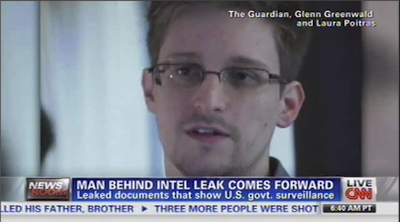


Contextualizing Events in TV News Shows
José Luis Redondo García, Laurens De Vocht, Raphaël Troncy, Erik Mannens, Rik Van de Walle <raphael.troncy@eurecom.fr>

Slide 2
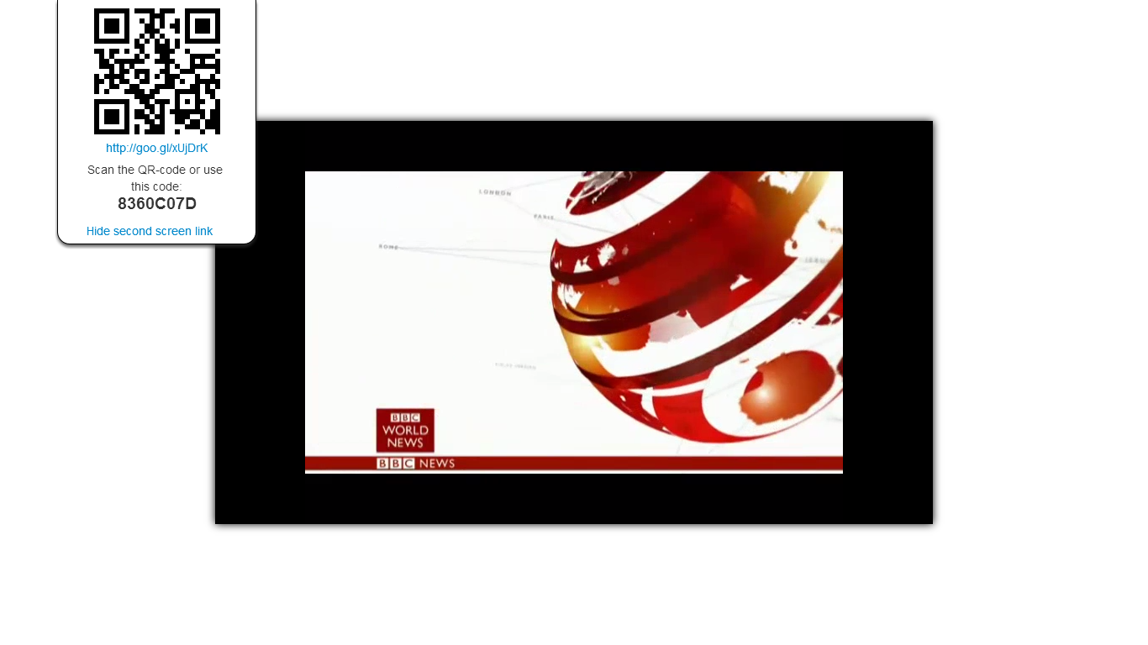

Slide 3
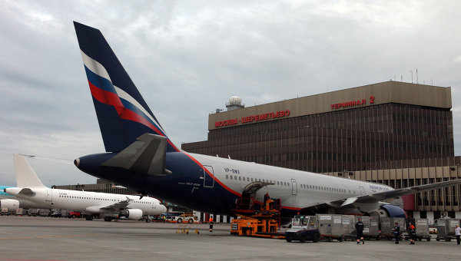
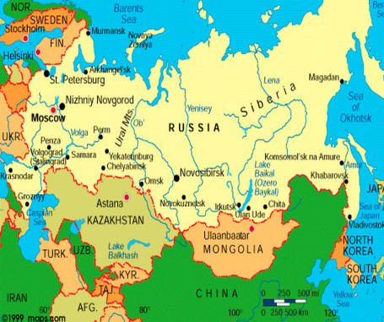
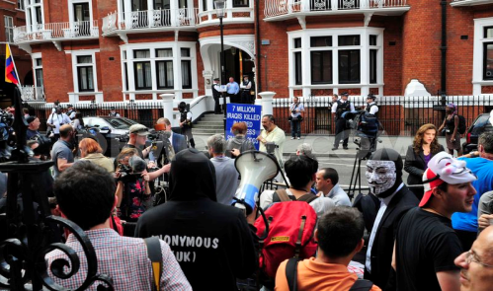
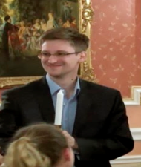
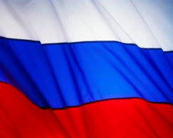


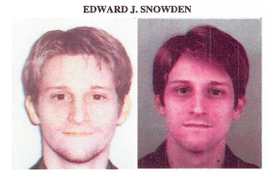
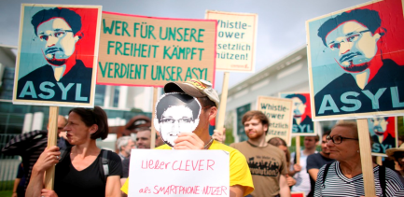
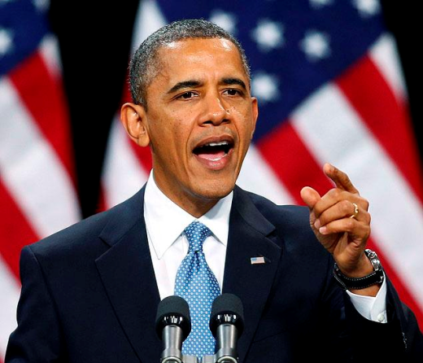
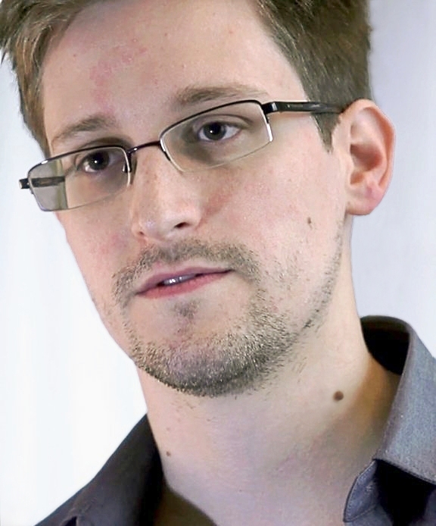
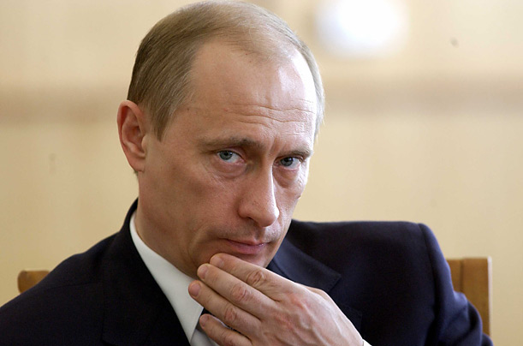
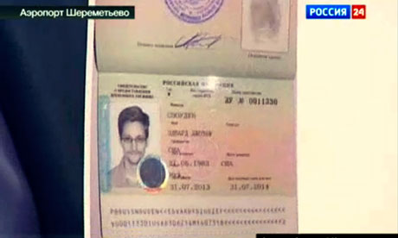

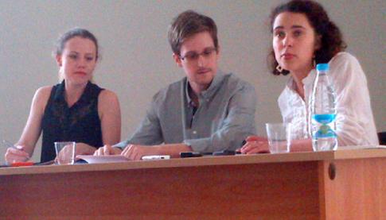
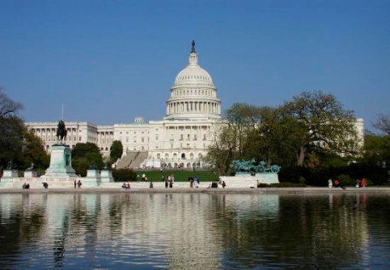
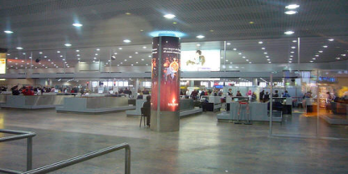

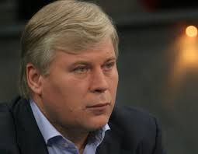



Problem: User Perspective
Edward Snowden asks for asylum in Russia (04 / 07 / 2013)

Slide 4
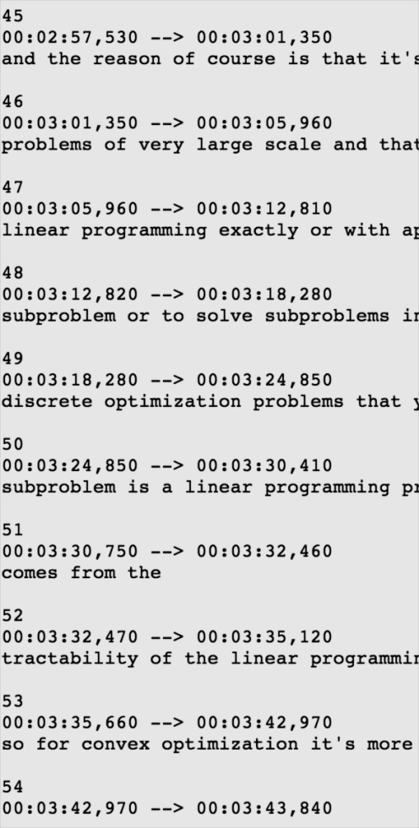
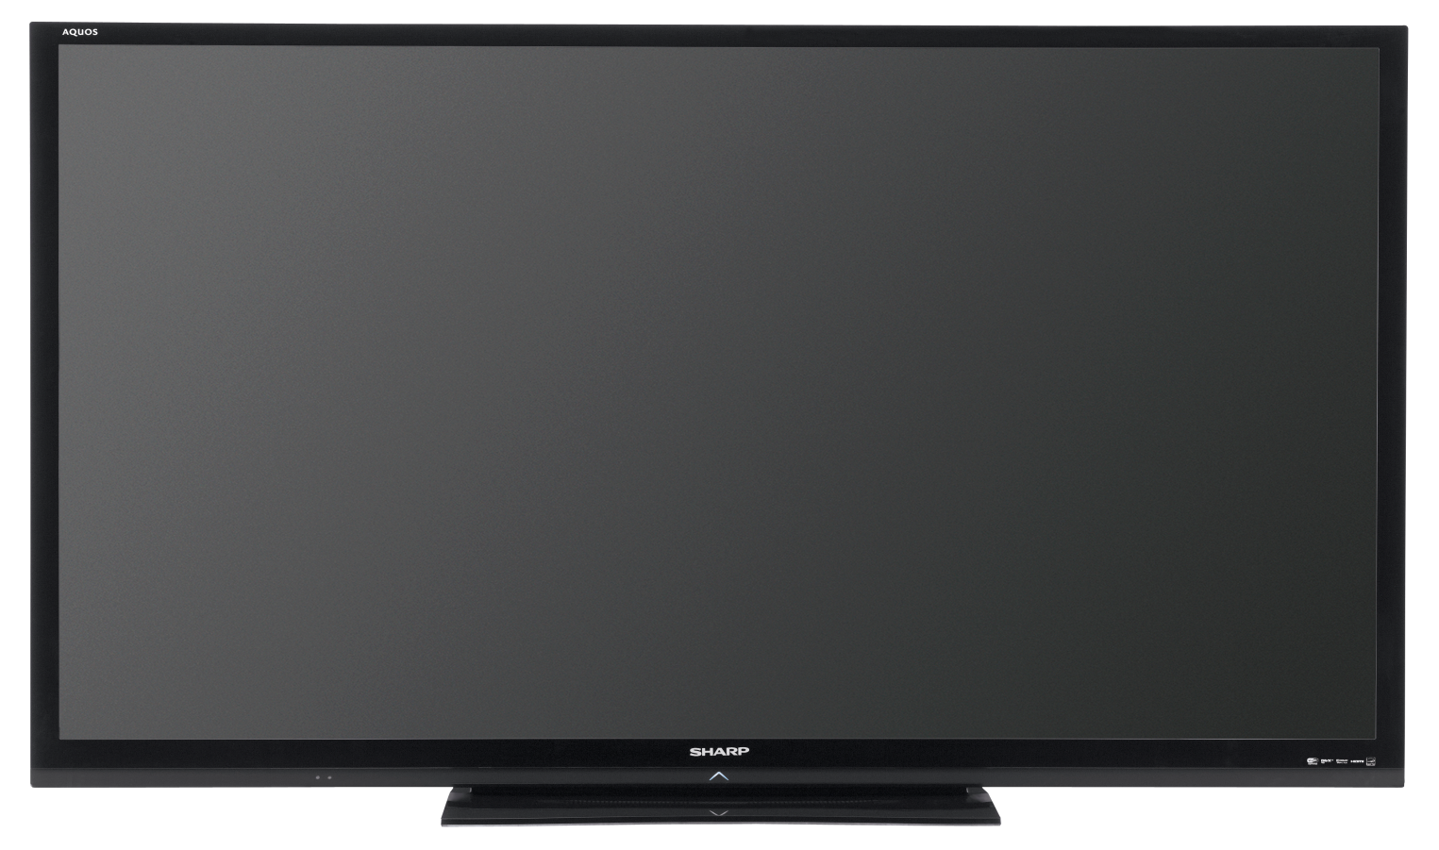
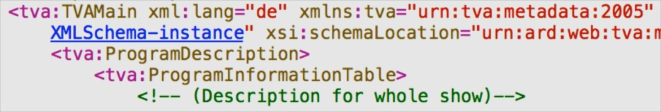


Problem: Technological Perspective
In which Russian airport is he exactly?
?
Subtitles
Metadata
OCR
Visual Concepts
LSCOM:Face
LSCOM:Building

Slide 5
Approach
a) Entities from Video
e_{a}
e_{b}
e_{c}
e_{d}
Event Entity Context:
List of Relevant Named Entities
(1) Named Entity Expansion
b) Expanded Entities
e_{a}
e_{b}
e_{c}
e_{d}
e_{f}
e_{g}
e_{h}
e_{i}
e_{j}
e_{k}
e_{l}
e_{m}
(2) DBpedia Filtering and Ranking
b) Re-ranked Entities
e_{a}
e_{c}
e_{h}
e_{j}
e_{k}
e_{m}

Slide 6
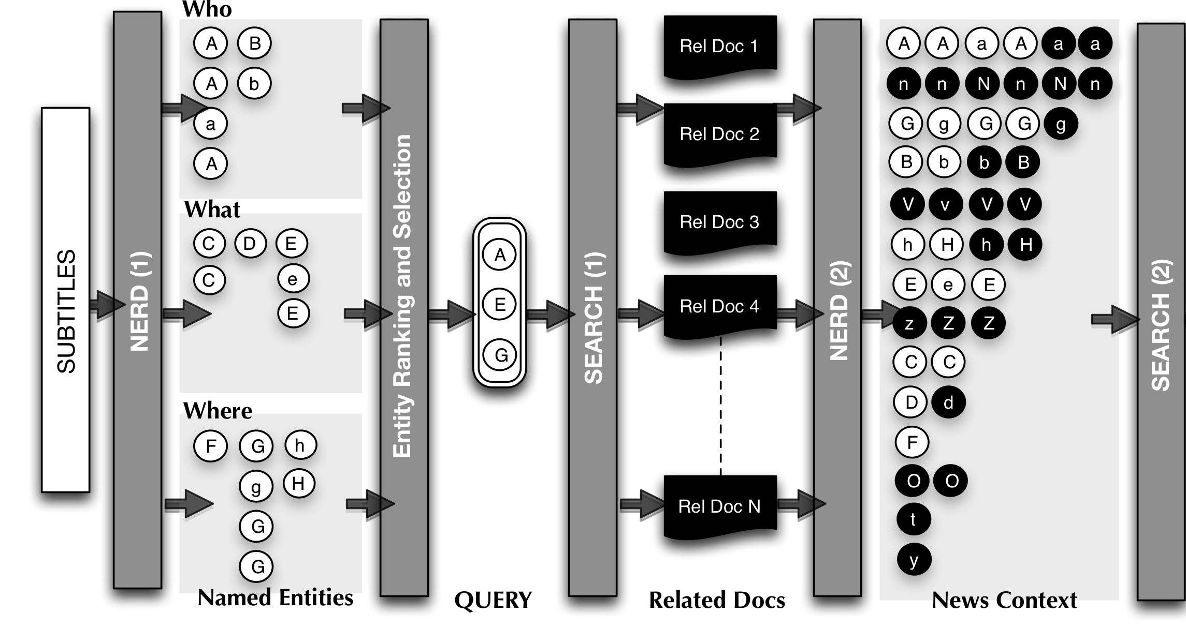
Named Entity Expansion

Slide 7











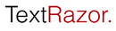




Named Entity Expansion: step 1
ontology¹
REST API²
UI³
¹ http://nerd.eurecom.fr/ontology
² http://nerd.eurecom.fr/api/application.wadl
³ http://nerd.eurecom.fr

Slide 8
Named Entity Expansion: step 2
Five W´s * ➔ Four W´s
Who: nerd:Person, nerd:Organization
What: nerd:Event, nerd:Function, nerd:Product
Where: nerd:Location
When: news program metadata
Entity Ranking and Selection:
Ranking according extractor’s confidence
Relative confidence falls in the upper quarter interval
Final Query:
Concatenate Labels of the selected entities in Who, What, Where, for a time t
(*) J. Li and L. Fei-Fei. What, where and who? classifying events by scene and object recognition

Slide 9

Named Entity Expansion: step 3
Query

Slide 10
Named Entity Expansion: step 4
Entity clustering:
Centroid-based approach
Distance metric:
Strict string similarity over the URL’s
Jaro-Winkler string distance over labels
Entity re-ranking according to:
Relative frequency in the transcripts
Relative frequency over the additional documents
Average confidence score from the extractors
Output:
Frequent entities are promoted
Entities not disambiguated can be identified with a URL by transitivity
Same happens with erroneous labels
Relevant but non-spotted entities arise (example: N)

Slide 11
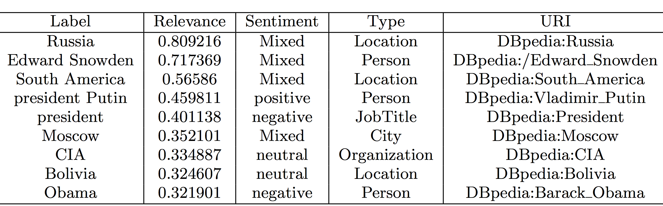
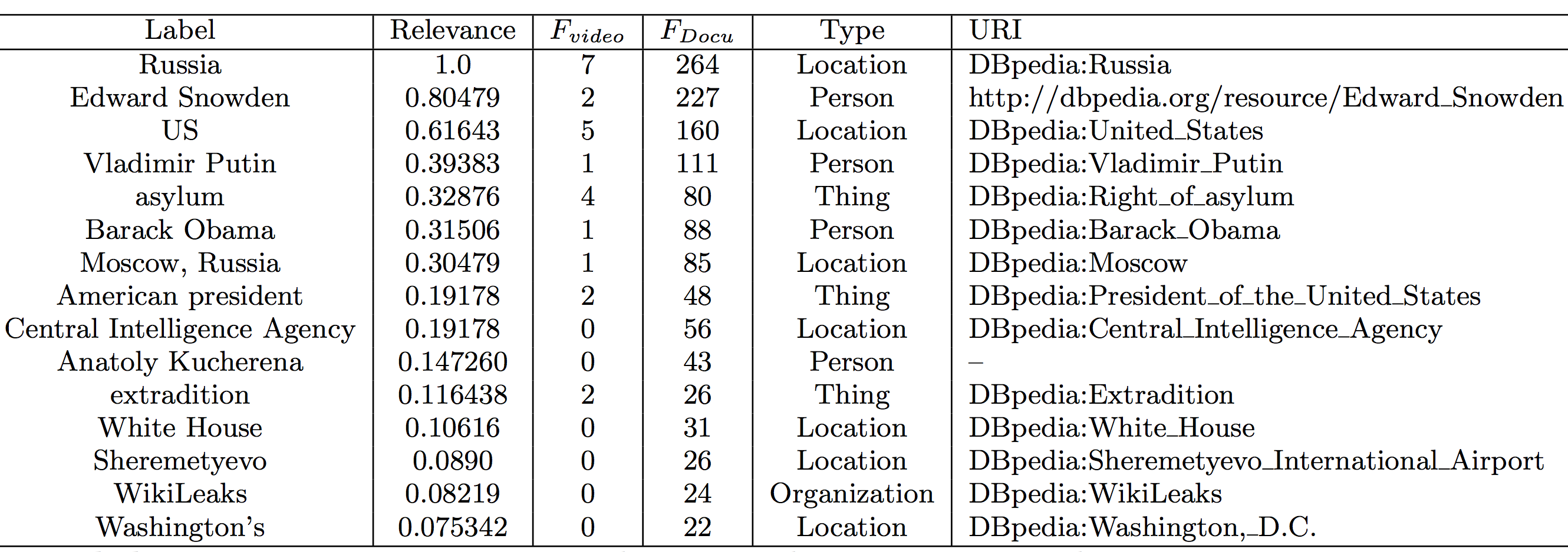
Named Entity Expansion: Results
Named Entity Expansion
➔
➔
➔
➔
✚




✚
✚
✚
✚
✚
✚
Notes:
REMINDER: Labels are better after the expansion, for example: Vladimir Putin

Slide 12
Approach
a) Entities from Video
e_{a}
e_{b}
e_{c}
e_{d}
Event Entity Context:
List of Relevant Named Entities
(1) Named Entity Expansion
b) Expanded Entities
e_{a}
e_{b}
e_{c}
e_{d}
e_{f}
e_{g}
e_{h}
e_{i}
e_{j}
e_{k}
e_{l}
e_{m}
(2) DBpedia Filtering and Ranking
b) Re-ranked Entities
e_{a}
e_{c}
e_{h}
e_{j}
e_{k}
e_{m}

Slide 13
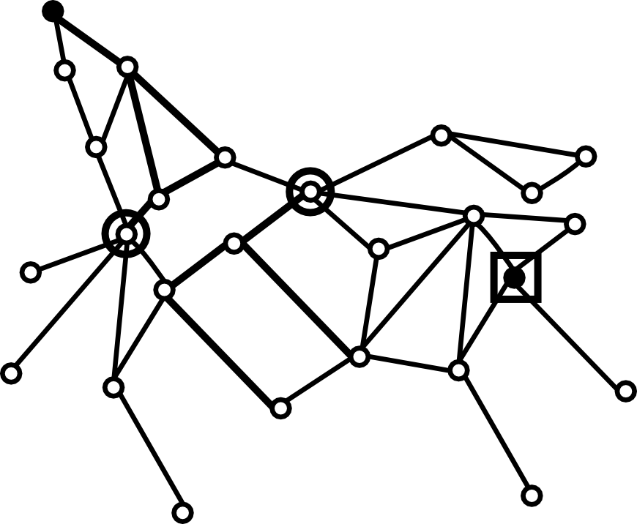
Refining via EiCE
For each pair of results:
Iteratively generate DBpedia paths using the EiCE engine [1]
: Barack_Obama
:Vladimir_Putin
[1] http://github.com/mmlab/eice

Slide 14
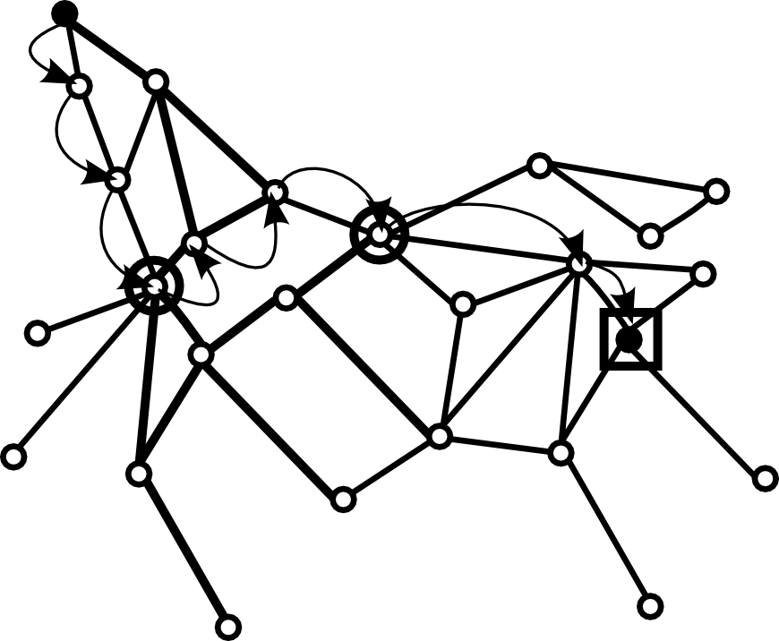
Refining via EiCE
Computing of initial path:
Preferring links with lower weight first (thinner lines)
: Barack_Obama
:Edward_Wilmot_Blyden_III
:United_States
:Vladimir_Putin
Path 1 = Barack Obama – Abdul Kallon – Freetown – United States - Edward_Wilmot_Blyden_III – Russia Vladimir_Putin

Slide 15
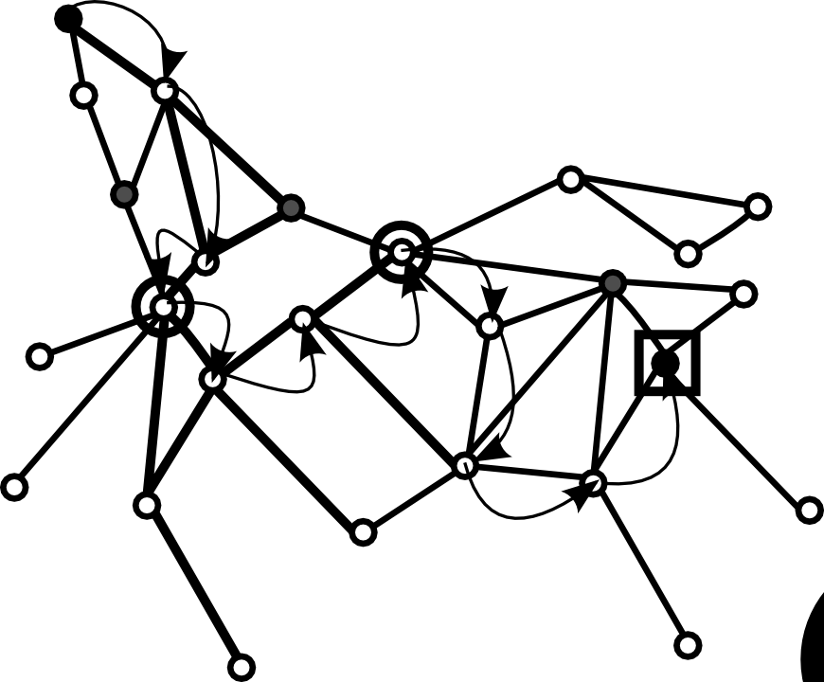
Refining via EiCE
Visited nodes being ignored in next iteration
: Barack_Obama
:Columbia_University
:Edward_Wilmot_Blyden_III
:Abdul_Kallon
:Russia
:United_States
:Vladimir_Putin
:NewYork
.
:United_States
:Independent
_(politician)
:New_York_City
(leader)
Path 2 = Barack Obama – Columbia University – United States – New York City– New York City(Leader) – Independent Politician -Vladimir_Putin

Slide 16
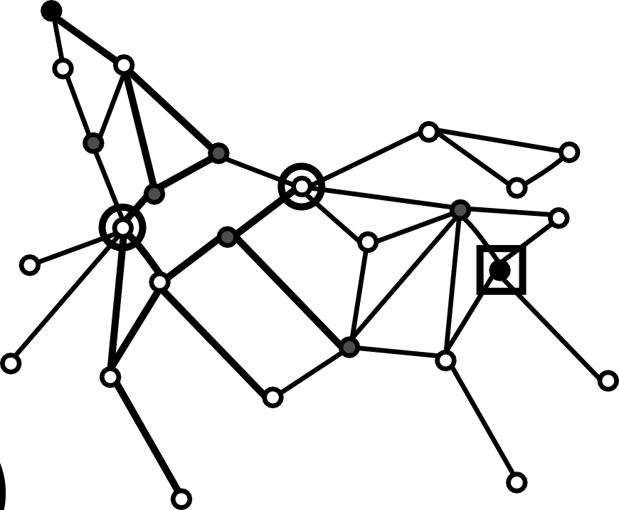

Refining via EiCE
Iterating continues until no more paths can be found
: Barack_Obama
:Vladimir_Putin

Slide 17
Refining via EiCE
Computation of the average path lengths after k iterations:
Length(Path 1) = 6
Length(Path 2) = 7
…
Length(Path k) = n
____________________________________________________________________________________________
Average_Length (:Barack_Obama, :Vladimir_Putin) = (13 + … + n)/k
Distance (:Barack_Obama, :Vladimir_Putin) (*) = normalize (Average_Length)
…
…
_____________________________________________________________________
Adjacency Matrix (**)
(*) http://demo.everythingisconnected.be/estimated_normalized_distance
(**) http://demo.everythingisconnected.be/estimated_normalized_distance_matrix

Slide 18
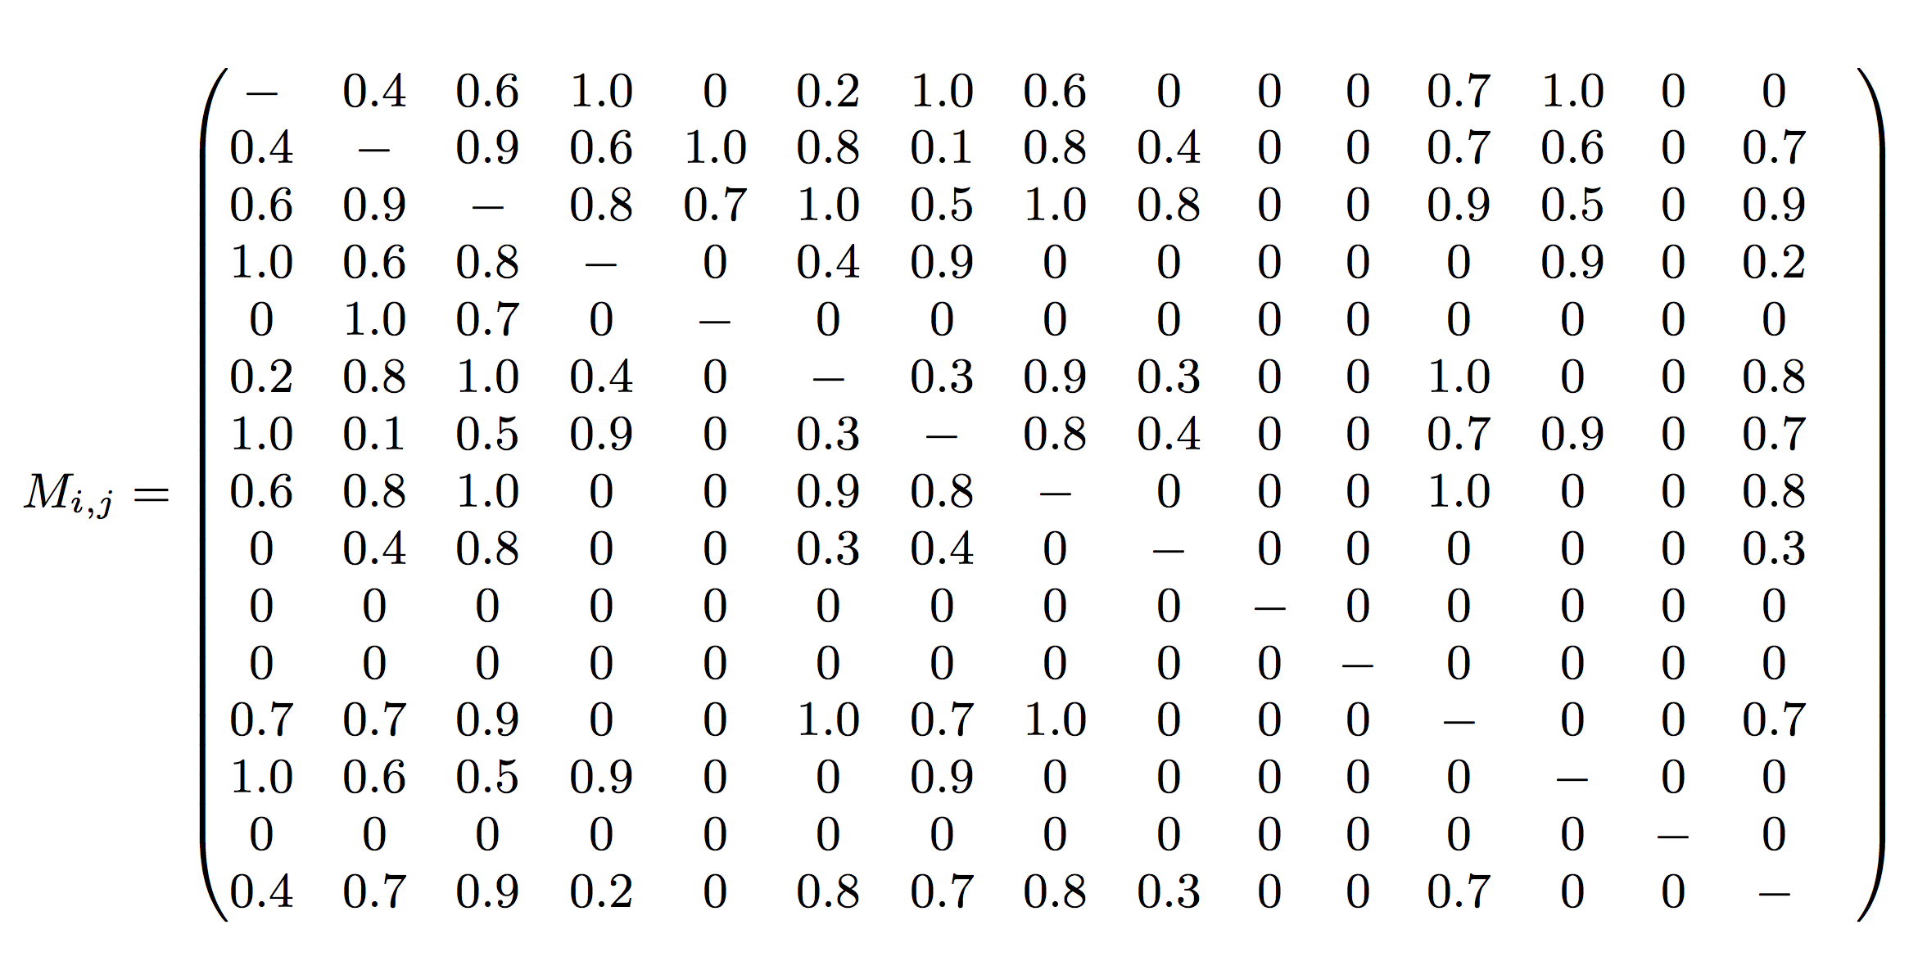
Refining via EiCE: Adjacency Matrix
Context Coherence
Wikileaks
Kucherena
Sheremetyevo
Adjacency Matrix M_{i,j}
D(e_{i} ,e_{j}) =Avg(lenght(Paths(e_{i}, e_{j} ))))

Slide 19
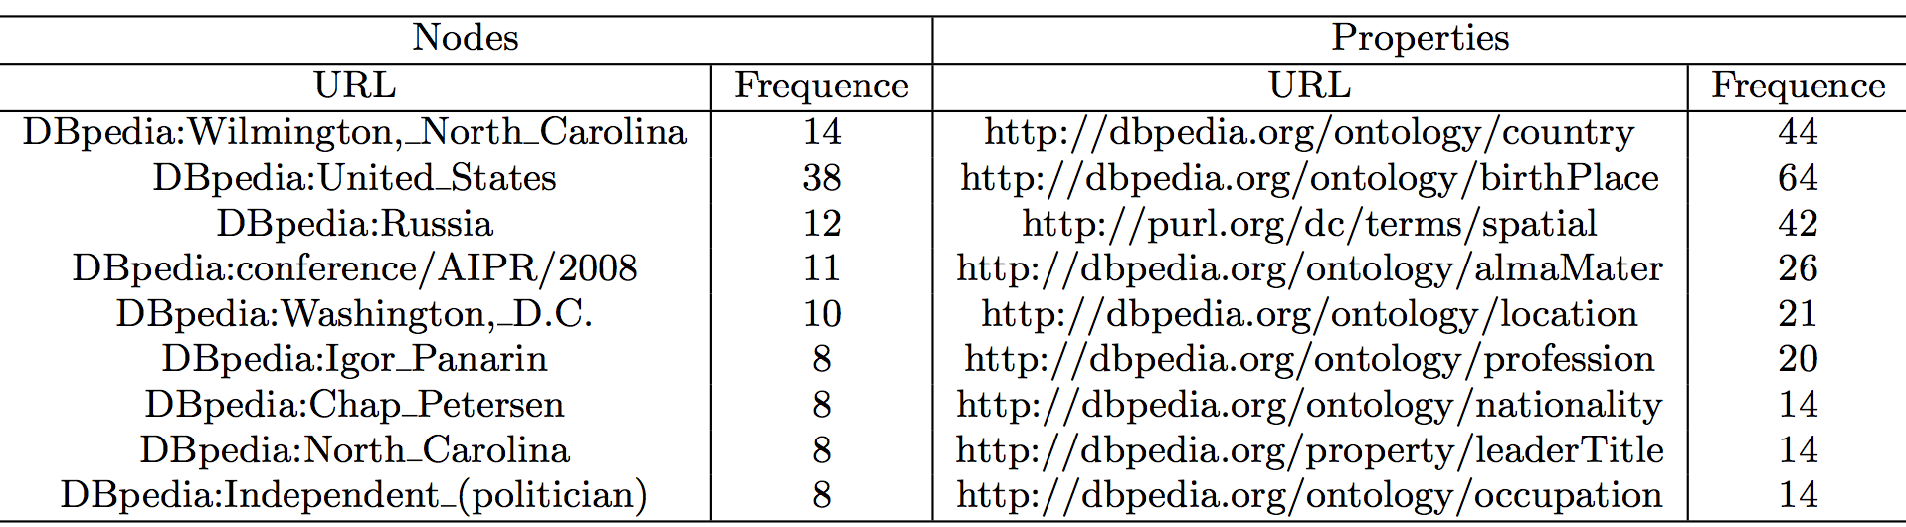
Refining via EiCE: Results
Frequent Nodes and Properties
⬅

⬅

⬅
⬅

⬅
⬅
⬅
⬅
⬅
Some frequent classes already detected are further promoted
In the context of the news program, geographical and political themes are dominant

Slide 20
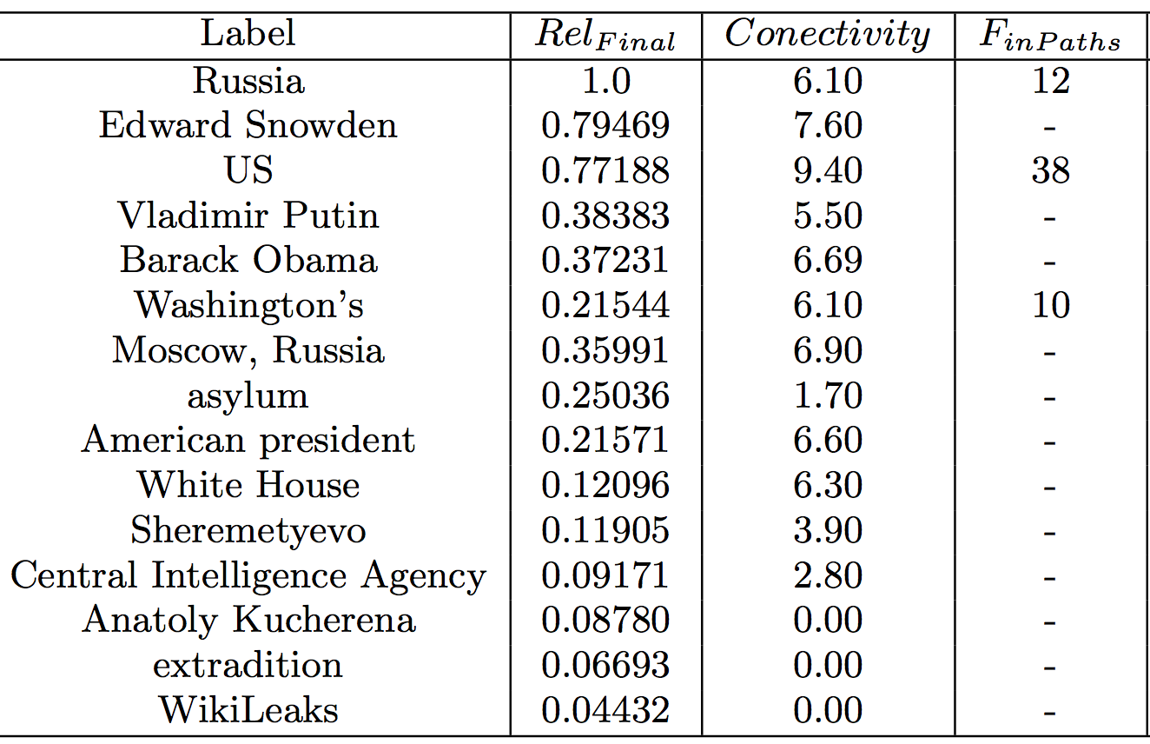
Refining via EiCE: Results
NE Expansion
DBPedia Connectivity
➔
➔
(2) Dbpedia Ranking
➔
➔


➔









Slide 21
Evaluation: Edward Snowden Asylum
Setup: Expert defines the list of relevant concepts for the newscast based on a deep analysis of the main argument and the feedback of 8 users participating in a user experience study [*]
GT Entity | Expert’s Comment | NE Extraction | NE Expansion | DBpedia Connectivity
Edward Snowden | Public figure. He is the “who” of the news | ✔ | ✔ | ✔
Russia | The location, but also an actor, the indirect object of the main sentence “”to whom” | ✔ | ✔ | ✔
Political Asylum | This is related to the “what” of the news. This is the Snowden’s request, the direct object. |  | ✔ | ✔
CIA | Background information on related to Snowden, since he is an ex-CIA employee. An axe in a wider sense, not this item in particular, but on Snowden’s history. | ✔ | ✔ | ✔
Sheremetyevo | Airport, specific location of the news |  | ✔ | ✔
Anatoly Kucherena | Secondary actor and speaker in the video. Information about an interview of person expressing his opinion. |  | ✔ | ✔
US Department of State | Involved organization. Not mentioned but related with the main subject
Other Entities |  |  | “human-rights” and “extradition” | Minister of Russia, “Igor Shuvalov”
Other Comments |  |  |  | Better ranking: Entities like “Sheremetyevo” scored higher
[*] L. Perez Romero, R. Ahn, and L. Hardman. LinkedTV News: designing a second screen companion for web-enriched news broadcasts.

Slide 22
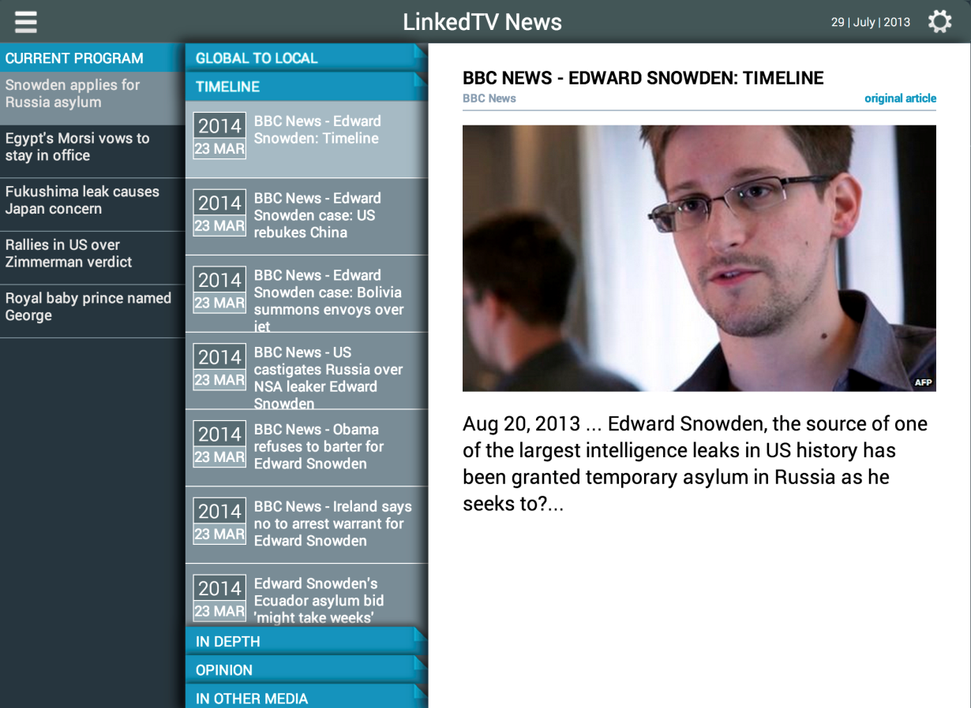
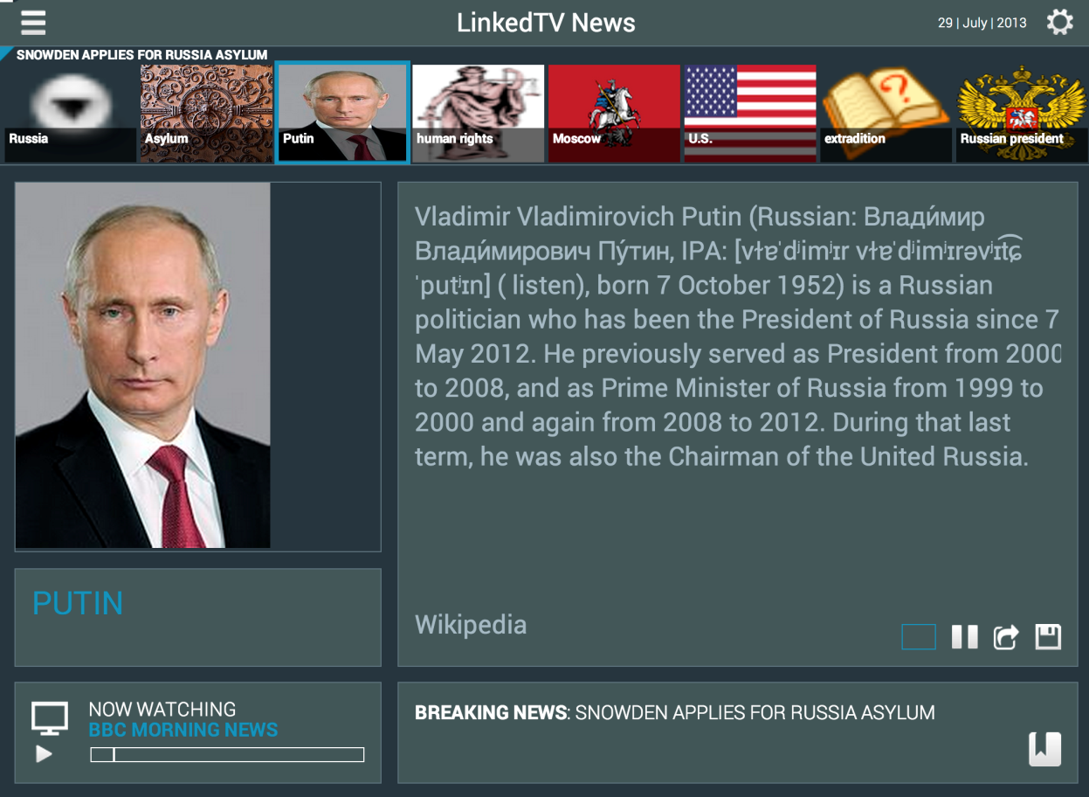
Feeding a companion second screen app
Main Screen @
http://linkedtv.project.cwi.nl/news/mainscreen.html
Second Screen @
http://linkedtv.project.cwi.nl/news/

Slide 23
Conclusion
Approach for context-aware annotating news events:
Start from named entities recognized in timed text
Expand this set by analyzing documents about the same event
Complete and re-rank exploring path connectivity in DBpedia
Preliminary results indicate that:
The initial set of entities is enhanced with relevant concepts not present in the original program
By exploring DBpedia paths we:
Obtain a more accurate ranking of the relevant concepts
Bring forward more related entities and filter out the ones which are less representative in the broader context of an event
This Entity Context provides valuable data for a second screen application that enhances user experience

Slide 24
Future Work
Evaluation involving more users and other programs
Named Entity expansion:
Study the adequacy of different extractors in NERD when:
Annotating the original transcripts of the video (representative entities)
Annotating additional documents found in the Web (relevant entities)
Introduce less ambiguity when generating the query by not only considering the surface form
Connectivity in DBpedia:
Analysis of the relevant properties for promoting other entities
Cluster algorithms over the Adjacency Matrix for detecting meaningful groups of entities

Slide 25
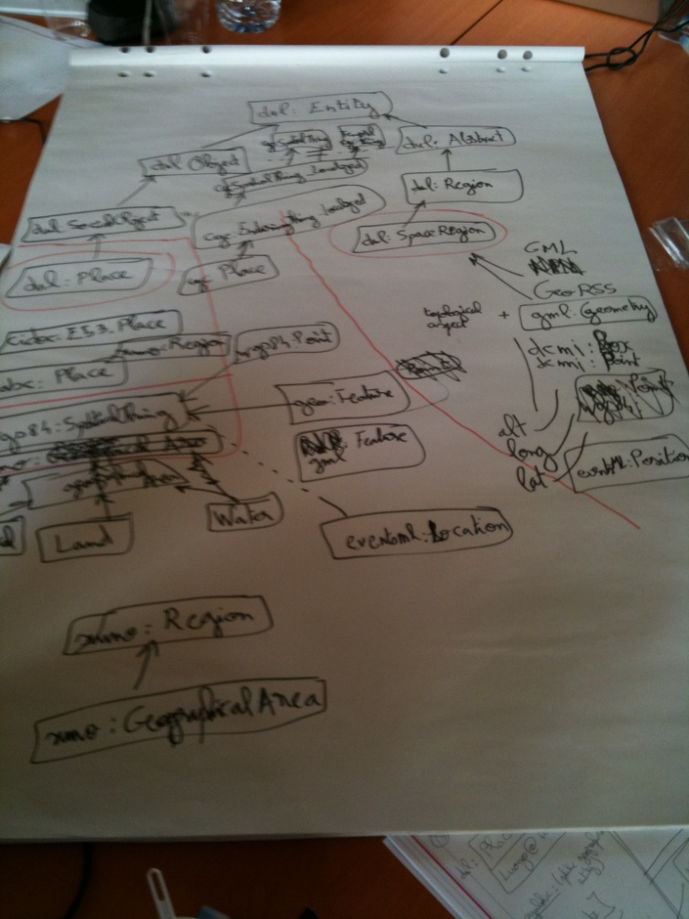
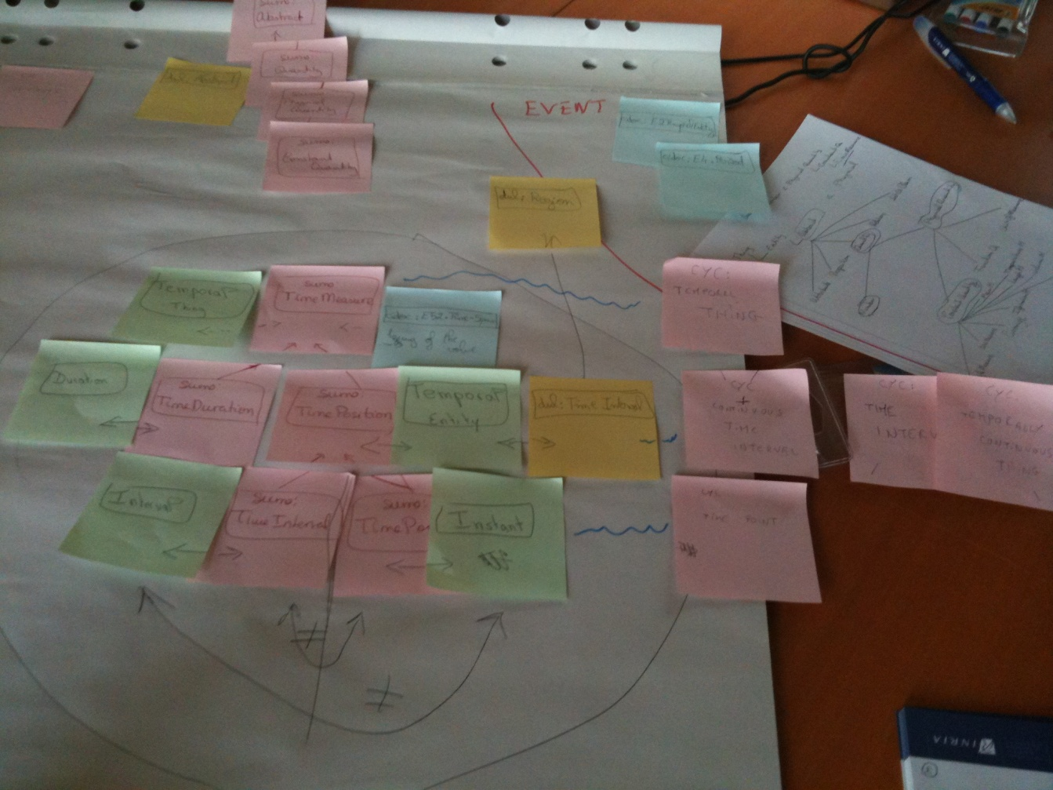

http://www.slideshare.net/troncy
- 25

